Slide 1


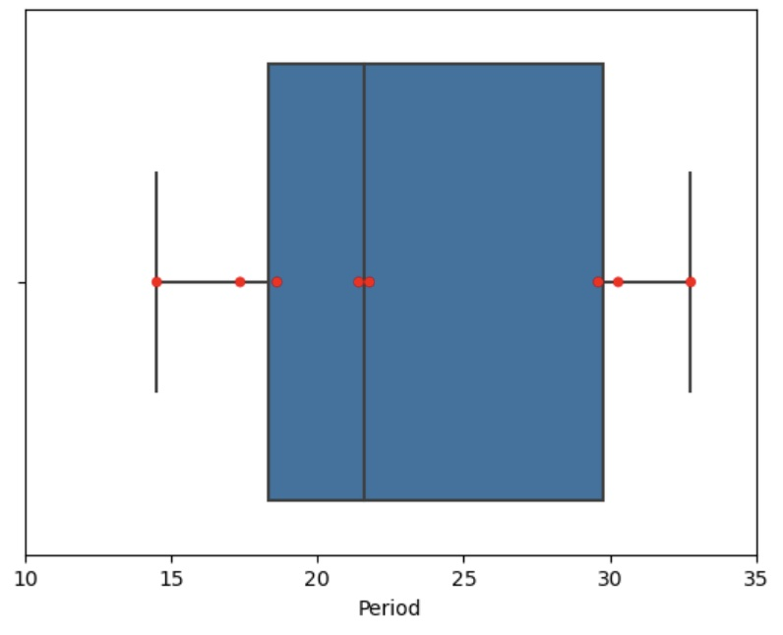
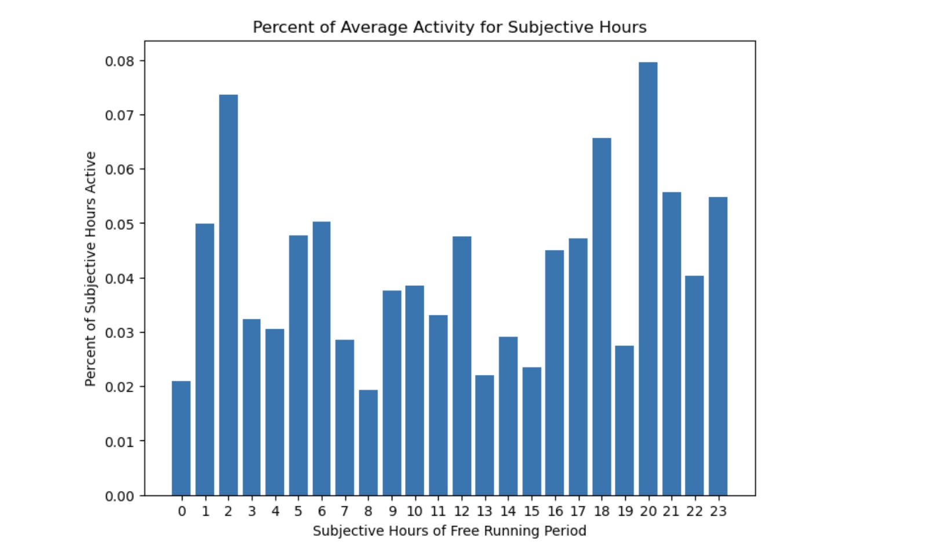
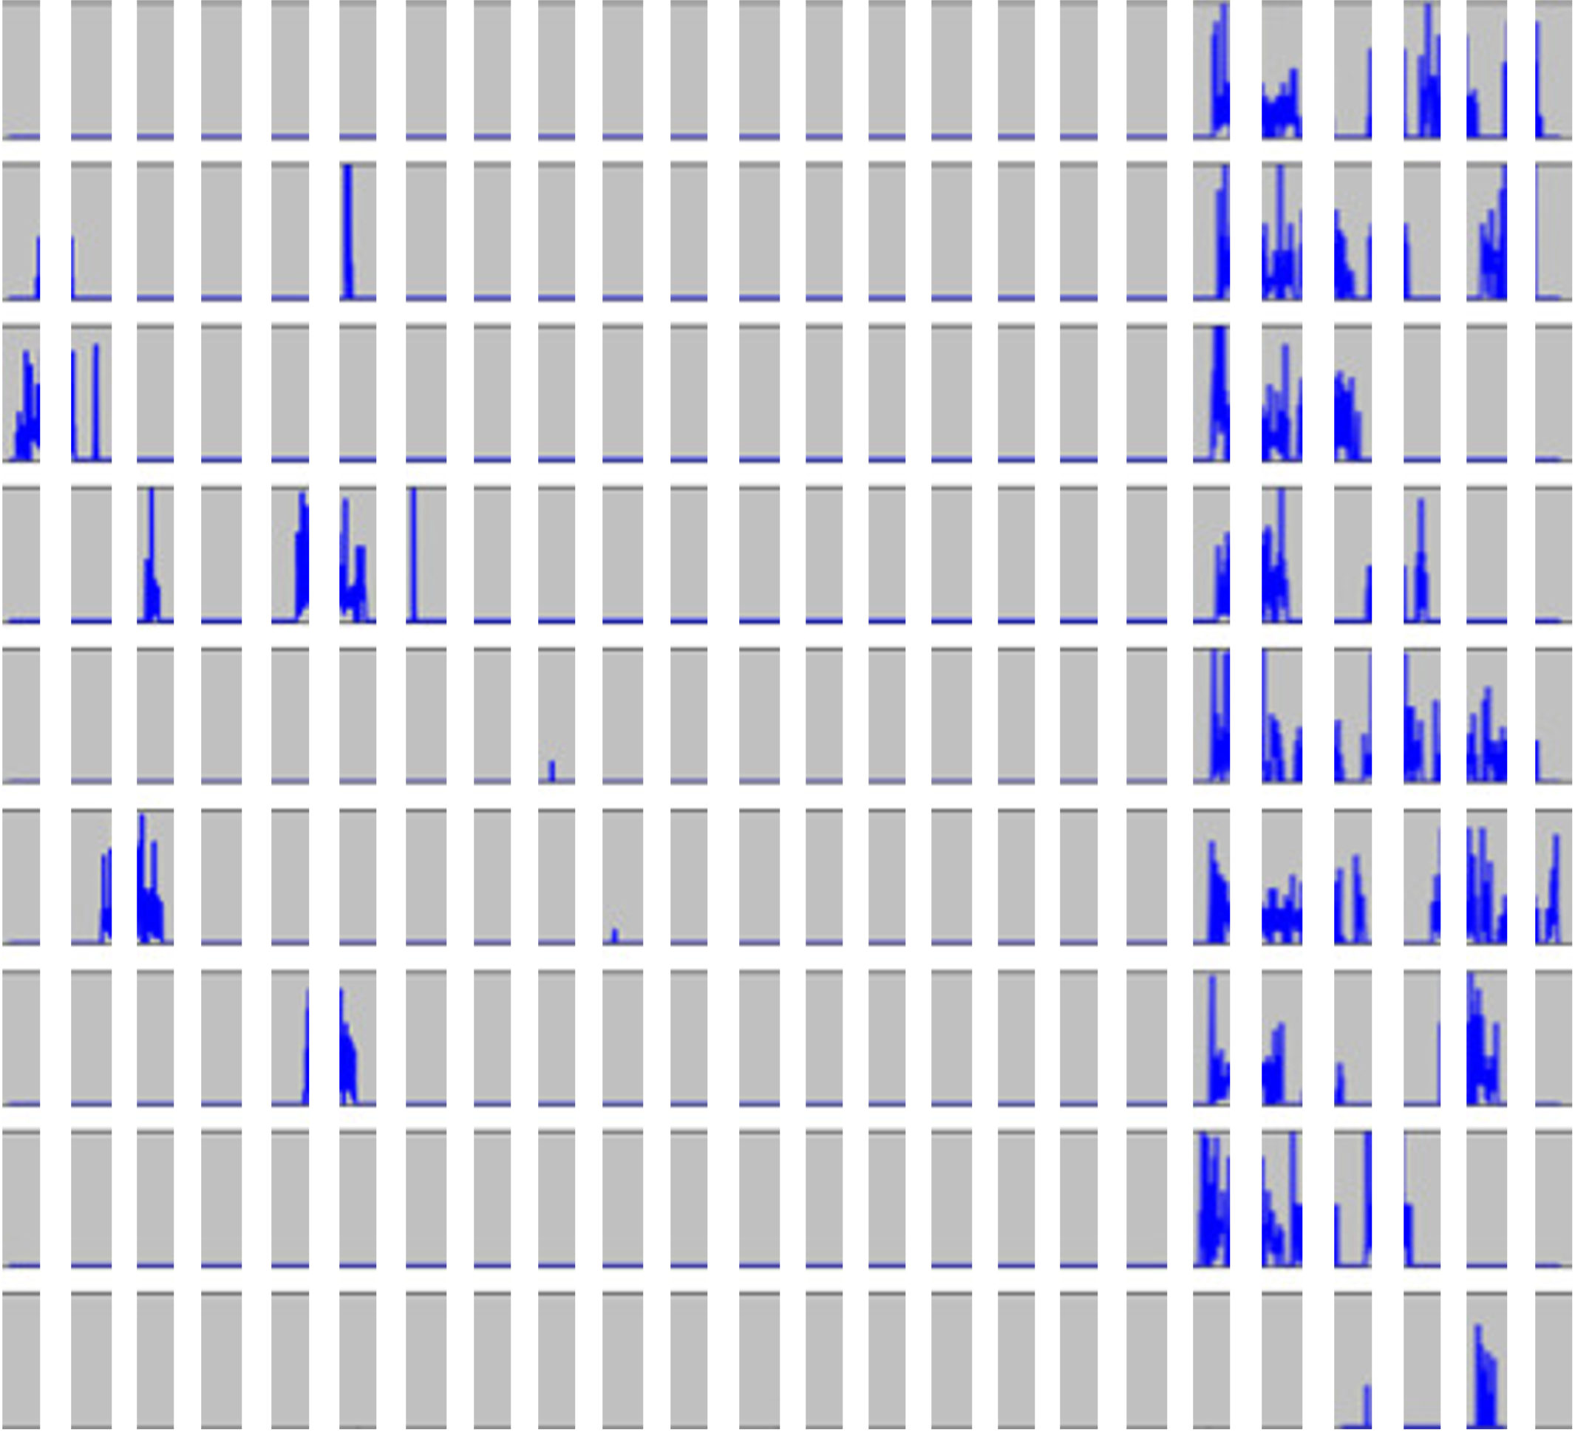
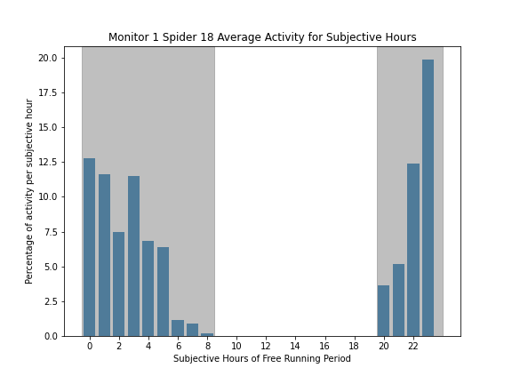

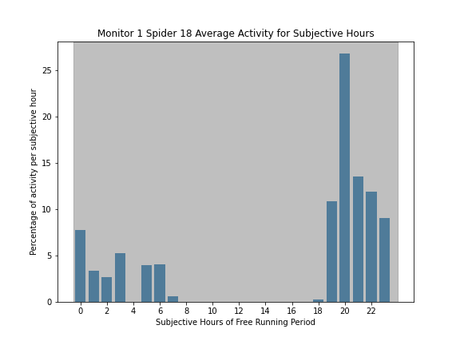

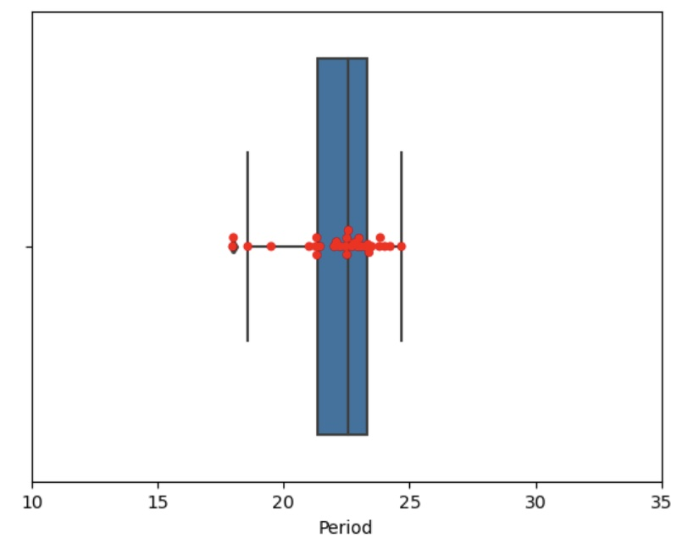
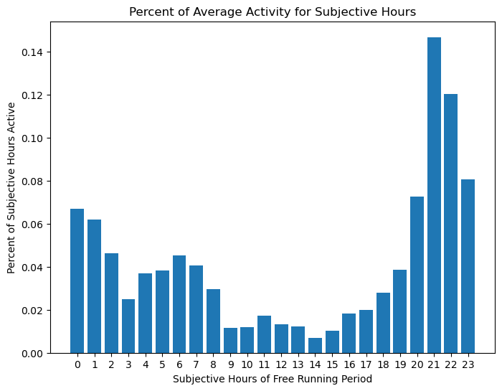
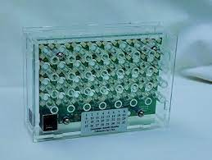
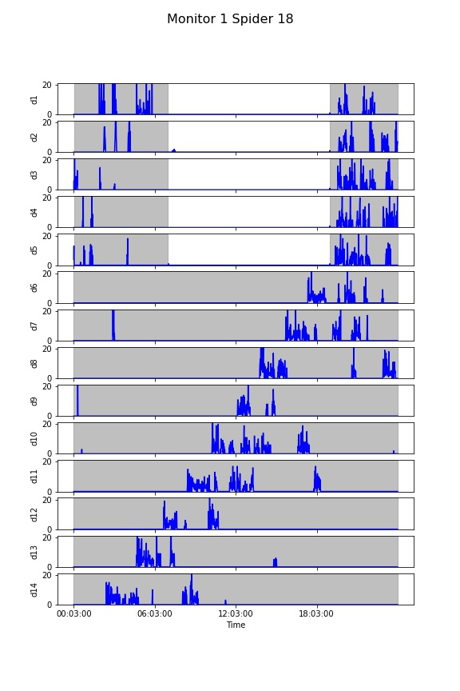
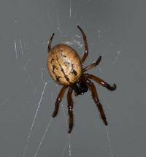
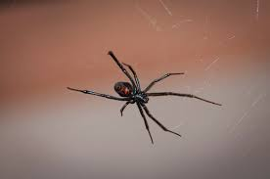
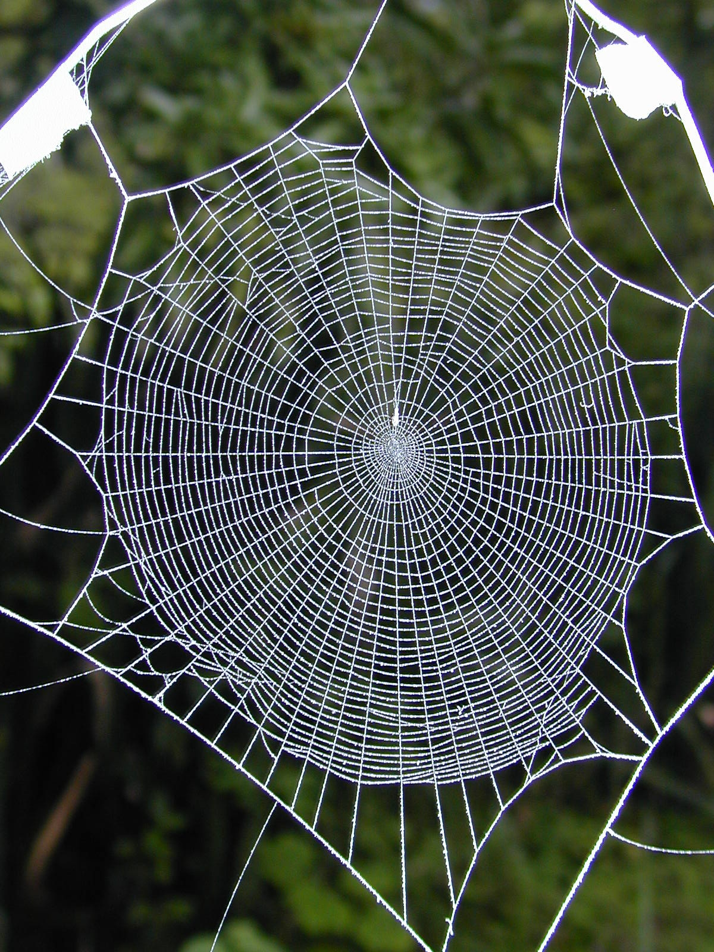
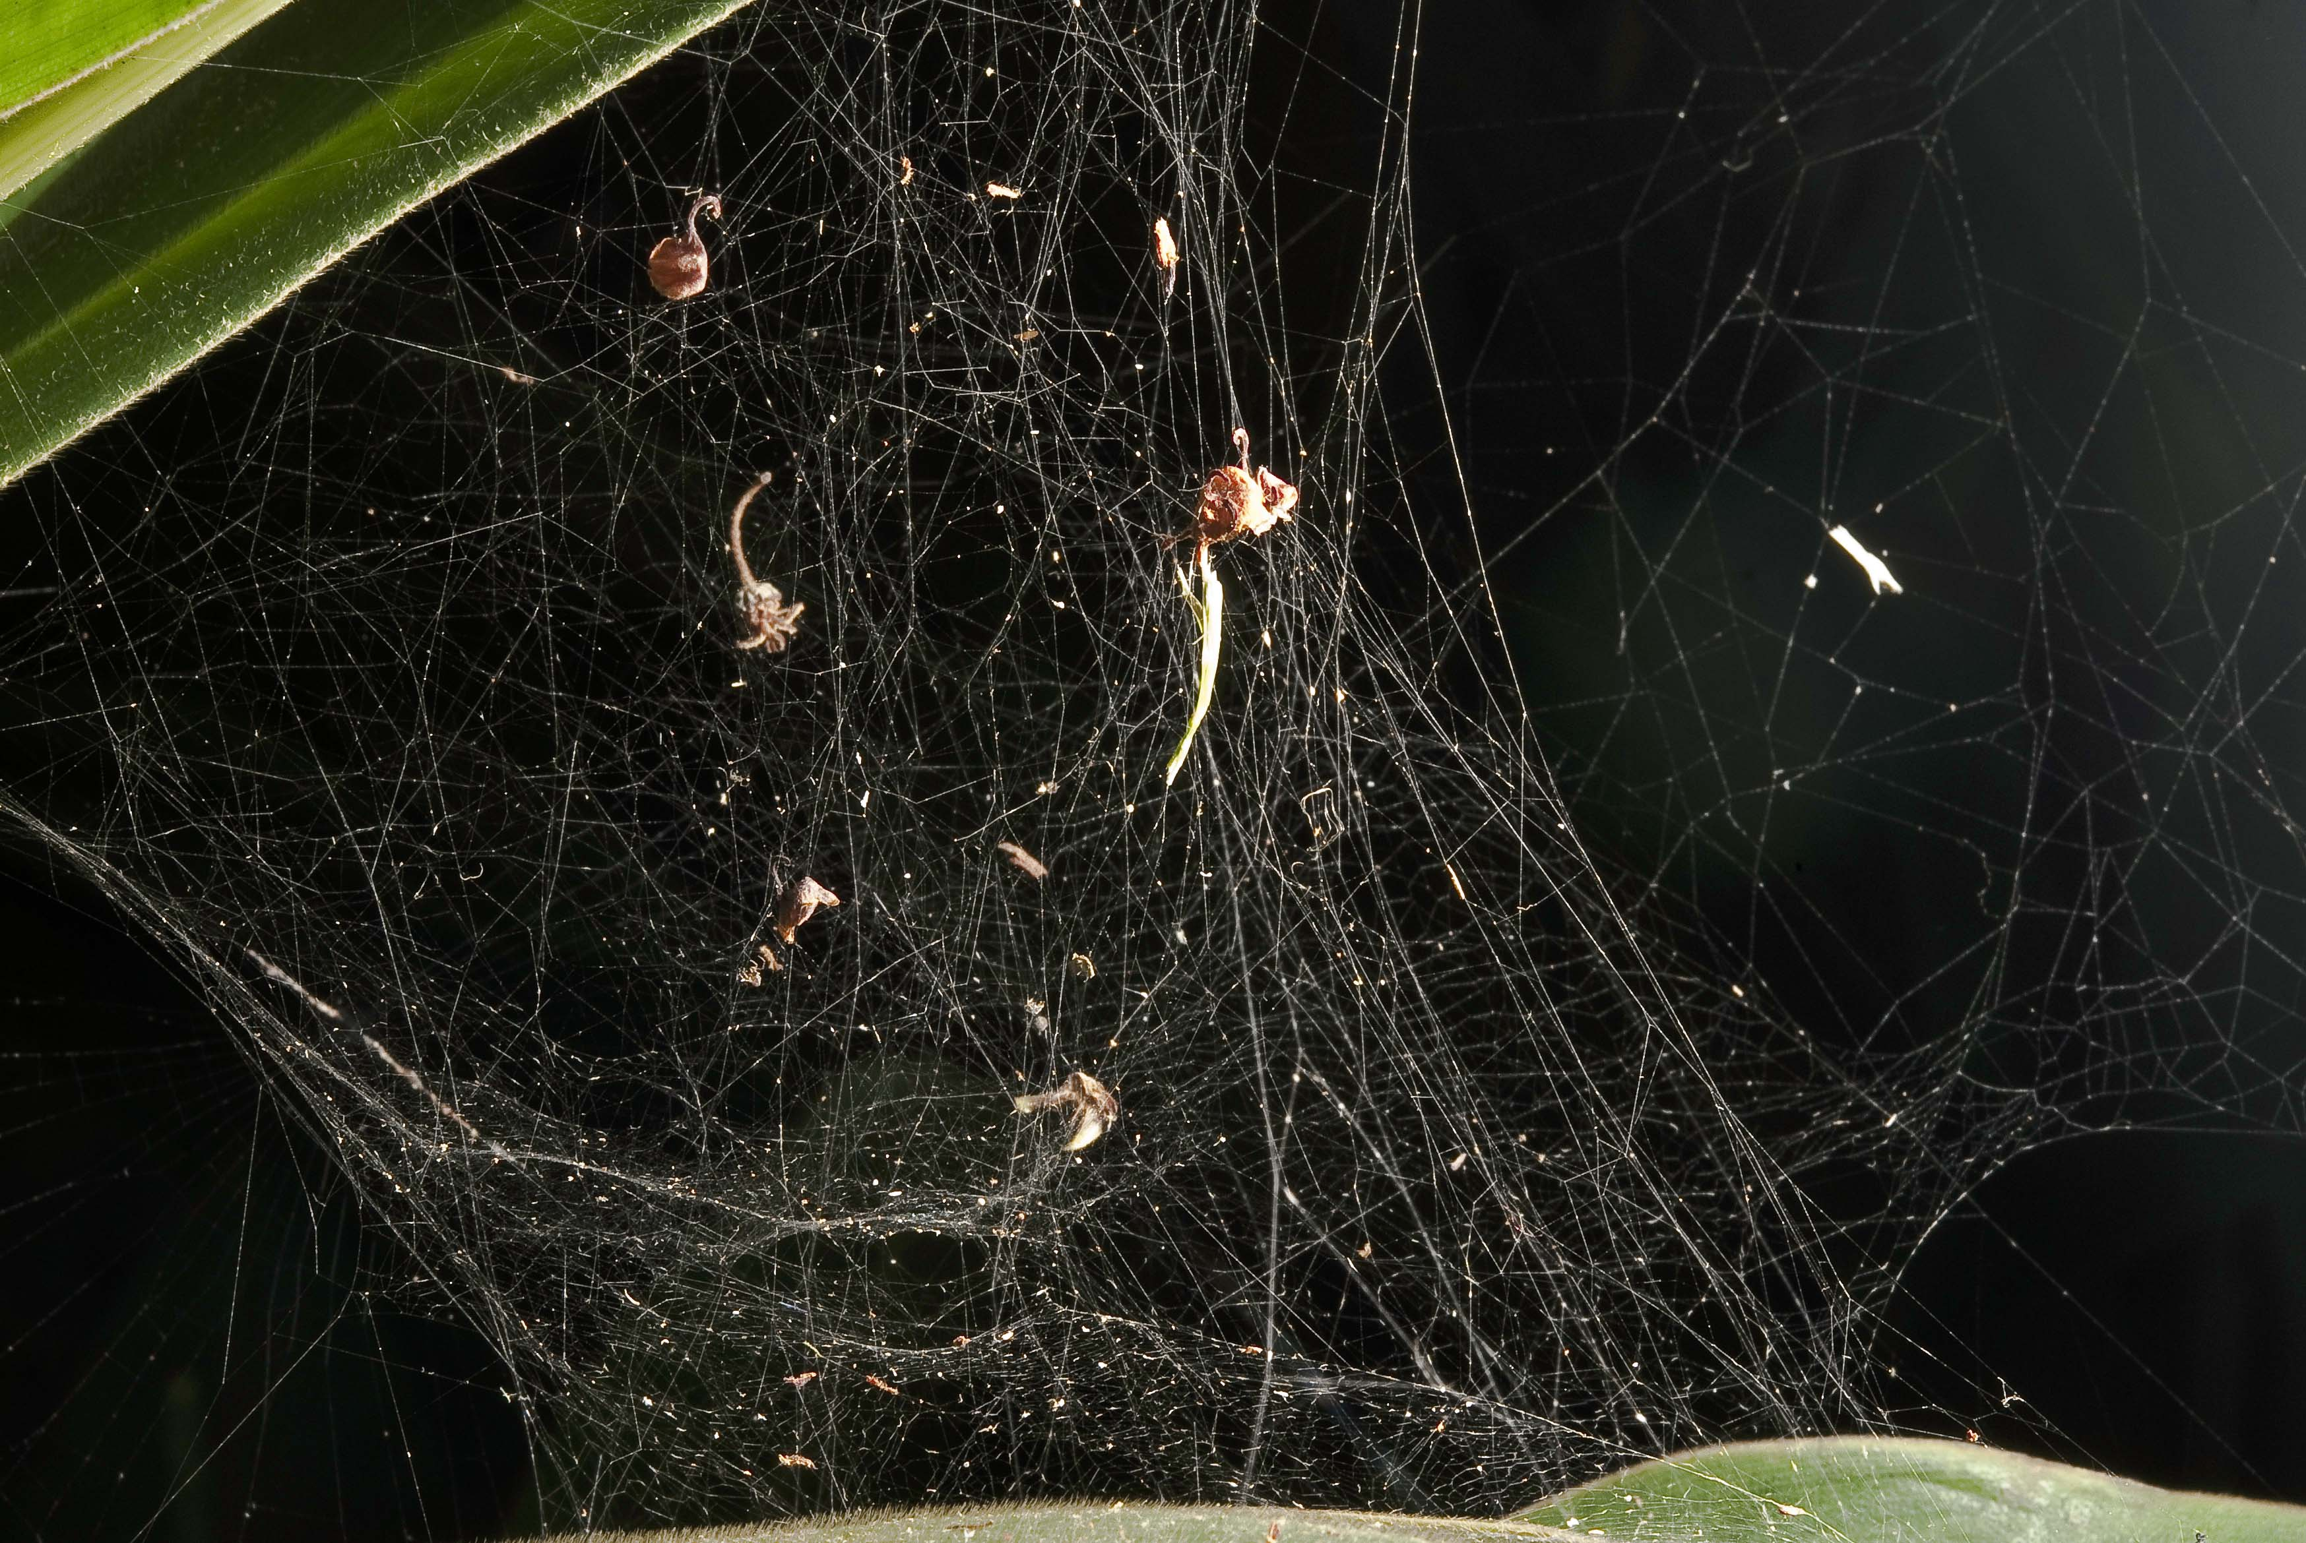
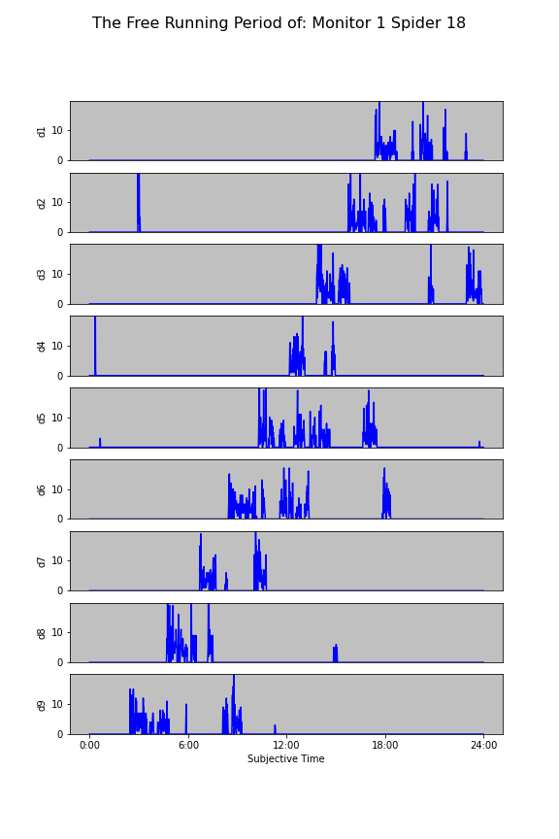
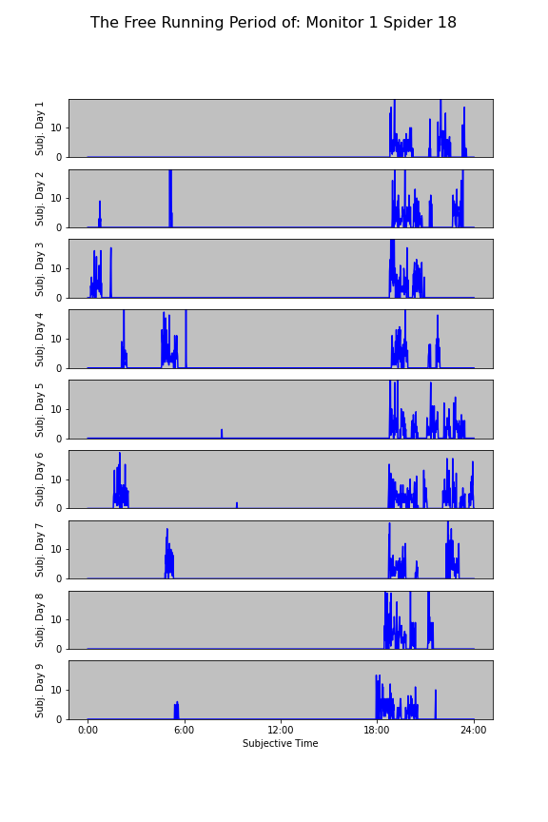
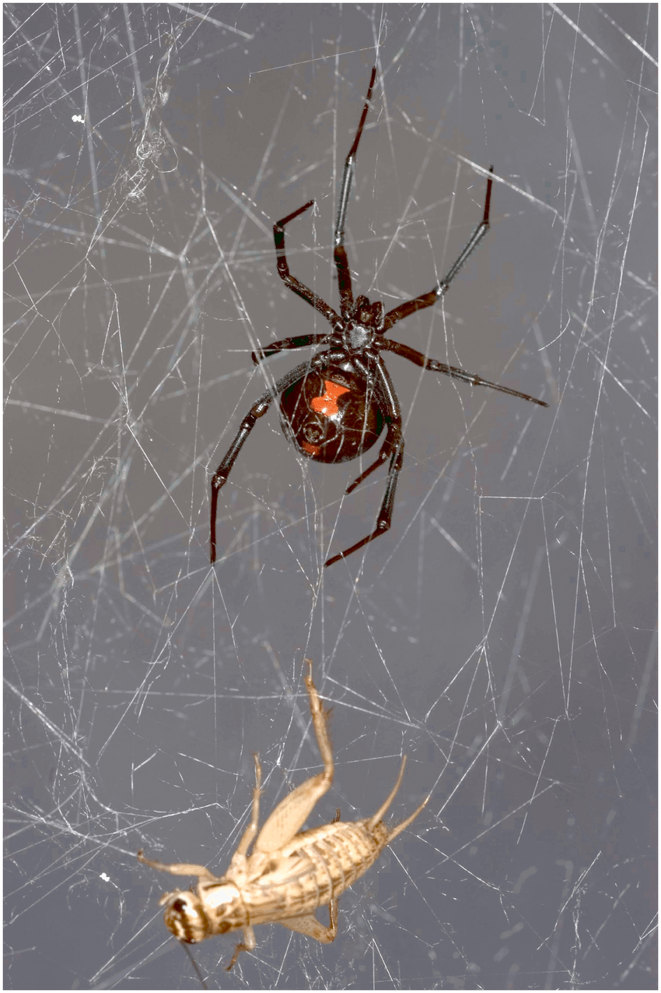
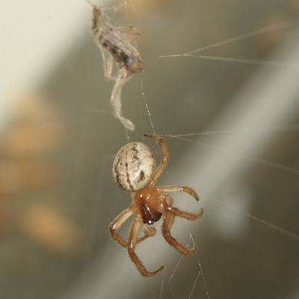
Modeling Spider Circadian Rhythms Through Gene Expression and Modeling
Emily Bradley, Schuyler Clark, Zihan Li, Darrell Moore, Nadia Ayoub, Natalia Toporikova
Introduction
s
Behavioral Analysis
Comparing Species
Spiders have a naturally wide range of free-running periods,
spanning anywhere from 16-32 hours.
Next, the plot was split into 24 equal segments (Figure 5) to compare the average activity in the DD cycle to the LD cycle. The average activity was graphed, and both graphs show similar trends (Figures 6,7).
Latrodectus mactans DD Period Distribution
Average Lactrodectus mactans Activity
Goals
Figure 5
Determine if there is a trend in activity data within a species using locomotor activity to indicate circadian entrainment
Compare the activity trends of different species to determine if there is a relationship between behavior patterns and circadian rhythms
0 6 12 18 23
Average Spider Activity
Average Spider Activity
Move spiders here
Metazygia wittfeldae DD Period Distribution
Average Metazygia wittfeldae Activity
A behavioral analysis was performed on 32 Metazygia wittfeldae spiders (Figure 1) at East Tennessee State University. We used Python to create raster plots to visualize circadian rhythms and their free-running period (Figures 1&2).
Average Number of Crossings
Average Number of Crossings
Figure 6
Figure 7
Comparing Species
Figure 10
Figure 11
Conclusion
Figure 1: The Trikinetics LAM25 Monitor was used to measure spider activity with infrared beams
There was a pattern in Metazygia wittfeldae despite the wide range of free running periods
The activity of each species reflected their feeding patterns
• Latrodectus mactans had sporadic activity
• Metazygia wittfeldae displayed a clear pattern reflective of its ritual feeding
Figure 2: The spiders were observed for 5 days on a 12-hour light/dark cycle. Then, the spiders were observed in complete darkness for 9 days.
Metazygia wittfeldae
Latrodectus mactans
0:00 6:00 12:00 18:00 24:00
The length of the spider’s new day was calculated using the Lomb-Scargle statistical model. This new period was used to make a new raster plot (Figures 3&4).
Next Steps
22.2 hours
22.2 hours
22.2 hours
22.2 hours
We will conduct a similar analysis on more species to investigate whether this trend hold true across multiple species
We plan to analyze the genetic processes of spider circadian cycles to determine what factors allow spider rhythms to be so adaptable
24 hours
24 hours
24 hours
24 hours
Spider Activity on a 24 Hour Day
Spider Activity on a 22.2 Hour “Day”
Figure 9: Latrodectus mactans is known to build tangle webs close to the ground.
Day 1
Day 1
Day 2
Day 2
Figure 8: Metazygia wittfeldae is known to build wheel-shaped orb webs suspended in the air.
Acknowledgements
Day 3
Day 3
Figure 10: Latrodectus mactans is an opportunistic feeder and searches its web whenever it detects prey
Day 4
Day 4
Dr. Toporikova, Washington and Lee University
Dr. Moore, East Tennessee State University
Kailesh Amilcar and Brian Kim
GRNT0157 NSF CR/RUI: Extraordinary circadian clocks in araneoid spiders
Day 5
Day 5
Figure 11: Metazygia wittfeldae checks its web for prey on a routine basis
Day 6
Day 6
Day 7
Day 7
Works Cited:
LOCOMOTOR AS CIRC RHYTHM
SPIDER BEHAVIOR
Day 8
Day 8
Day 9
0:00 6:00 12:00 18:00 24:00
Day 9
“0:00” “6:00” “12:00” “18:00” “24:00”
Figure 3
Figure 4

Slide 2
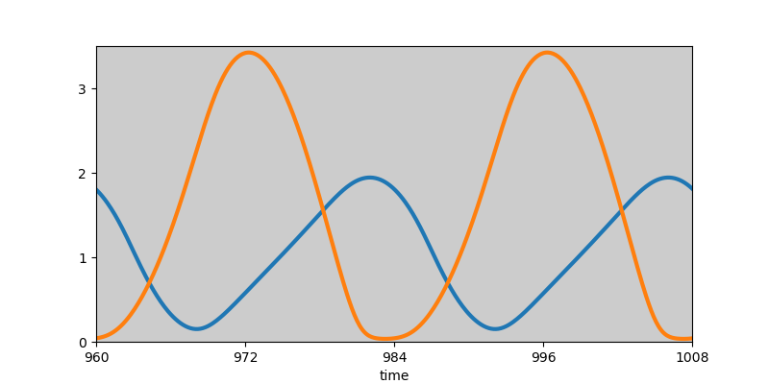
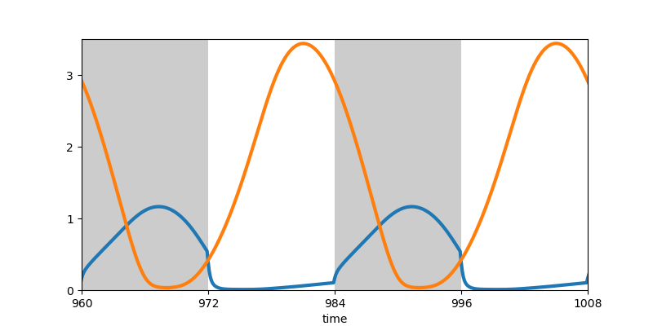

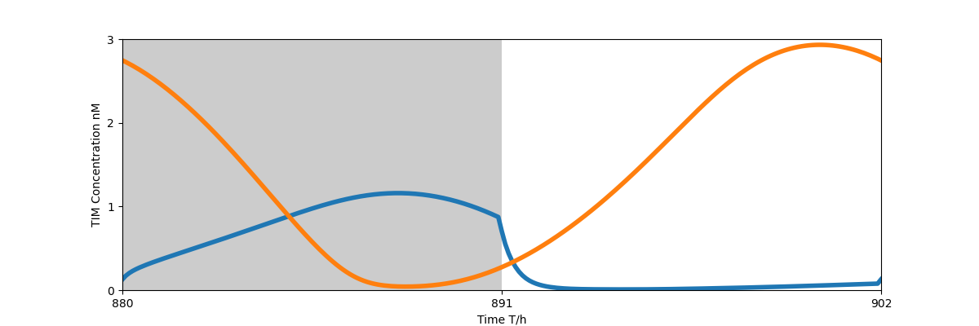
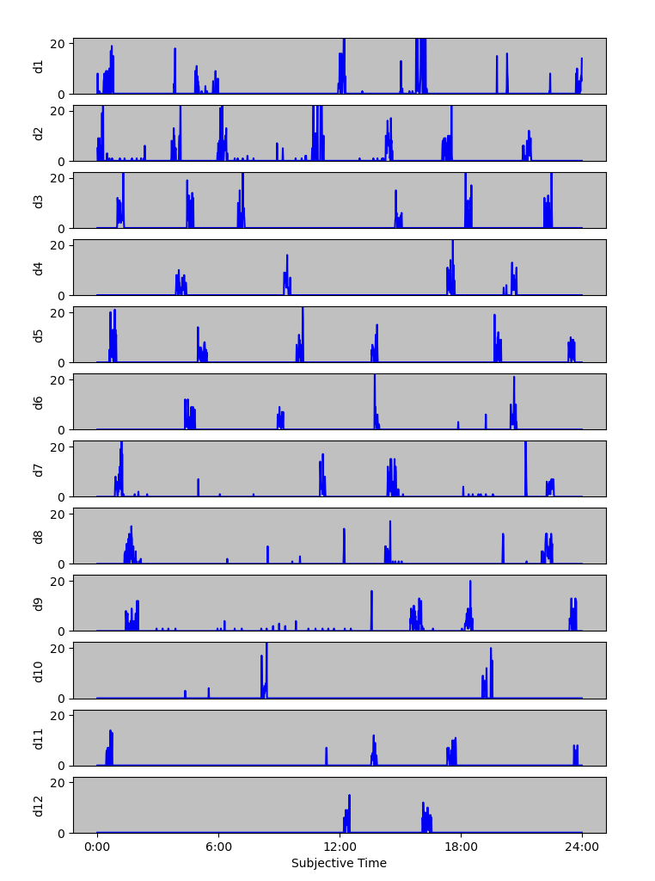

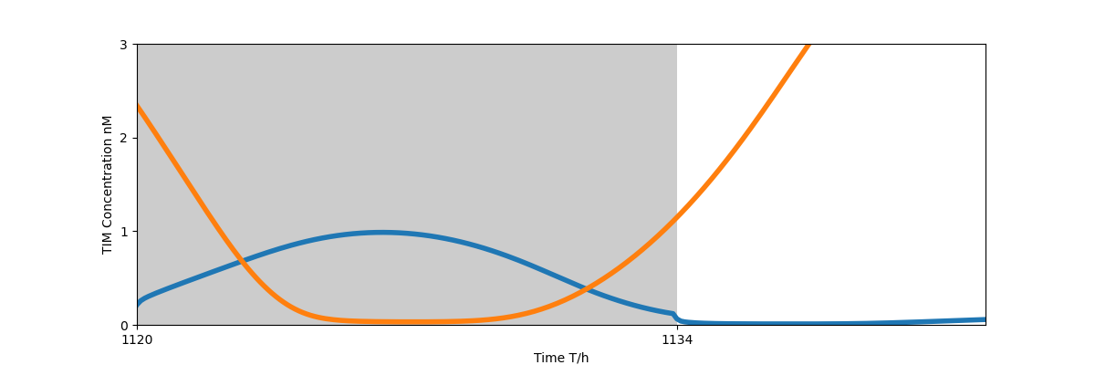

Modeling Spider Circadian Rhythms Through Gene Expression and Modeling
Emily Bradley, Schuyler Clark, Zihan Li, Darrell Moore, Nadia Ayoub, Natalia Toporikova
Goals
s
e
Consistent Activity Pattern
Modeling^{[1]} Predictions
Determine if there is a trend in activity data within a species using locomotor activity to indicate circadian entrainment
Compare the activity trends of different species to determine if there is a relationship between behavior patterns and circadian rhythms
Next, the plot was split into 24 equal segments to compare the average activity in the DD cycle to the LD cycle. The average activity was graphed, and both graphs show similar trends
DD
LD 12:12
3
TIM
CLK
3
TIM
CLK
[Protein] nM
2
2
Metazygia wittfeldae | Latrodectus mactans
1
1
0
12
24
36
48
0
12
24
36
48
Wheel-shaped orb webs suspended in the air
Tangle webs close to the ground
Time (h)
Time (h)
0 6 12 18 23
Model predicts earlier peak with longer days
Average Spider Activity
Average Spider Activity
3
Checks its web for prey on a routine basis
Opportunistic feeder and searches its web whenever it detects prey
[Protein] nM
2
TIM
CLK
PER
TIM
PER-TIM complex
1
Average Number of Crossings
Average Number of Crossings
Nucleus
0
11
22
per, tim
3
TIM
CLK
Activity raster displays shifting pattern in DD
Activity raster displays sporadic bursts of movement
[Protein] nM
2
CLK complex
clk
1
Subjective Hours
Subjective Hours
CLK
0
14
22
Black Widow vs. Orb Weaver
Time (h)
Free Running Periods
Conclusion
Latrodectus mactans DD Period Distribution
Average Latrodectus mactans Activity
The length of the spider’s new day was calculated using the Lomb-Scargle statistical model. This new period was used to make a new raster plot.
There existed a pattern in Metazygia wittfeldae despite the wide range of free running periods
The activity of each species reflected their feeding patterns
• Latrodectus mactans had sporadic activity
• Metazygia wittfeldae displayed a clear pattern reflective of its ritual feeding
22.2 hours
22.2 hours
22.2 hours
22.2 hours
24 hours
24 hours
24 hours
24 hours
Percent of Subjective Hours Active
Spider Activity on a 24 Hour Day
Spider Activity on a 22.2 Hour “Day”
Next Steps
Day 1
Day 1
We will conduct a similar analysis on more species to investigate whether this trend hold true across multiple species
We plan to analyze the genetic processes of spider circadian cycles to determine what factors allow spider rhythms to be so adaptable
Day 2
Day 2
Period (Hours)
Subjective Hours of Free-Running Period
Day 3
Day 3
Metazygia wittfeldae DD Period Distribution
Average Metazygia wittfeldae Activity
Day 4
Day 4
Acknowledgements
Day 5
Day 5
Percent of Subjective Hours Active
Dr. Toporikova, Washington and Lee University
Dr. Moore, East Tennessee State University
Kailesh Amilcar and Brian Kim
GRNT0157 NSF CR/RUI: Extraordinary circadian clocks in araneoid spiders
Day 6
Day 6
Day 7
Day 7
Day 8
Day 8
Works Cited:
LOCOMOTOR AS CIRC RHYTHM
SPIDER BEHAVIOR
[1]: Ueda, H. R., Hagiwara, M., & Kitano, H. (2001). Robust oscillations within the interlocked feedback model of Drosophila circadian rhythm. Journal of theoretical biology, 210(4), 401–406. https://doi.org/10.1006/jtbi.2000.2226
Day 9
0:00 6:00 12:00 18:00 24:00
Day 9
Period (Hours)
Subjective Hours of Free-Running Period
“0:00” “6:00” “12:00” “18:00” “24:00”
Notes:
Spider: predator and prey (Why have a clock, hide from predation and hunt prey)
Black Widow – arythmatic and consistent pattern
Criteria for arythmatic exclusion
How many days removed
Other insects patterns similar spider??
Different activity patterns shown in BW- look at rasters and see which ones prefer early activity vs late activity
Elizabeth Teaff
Cc Dr. T

